Slide 2
Assembly: Celebrating our families and our differences
Notes:
Today we going to be looking at how we are all different, how all of our families are different but that is something we should celebrate!

Slide 3
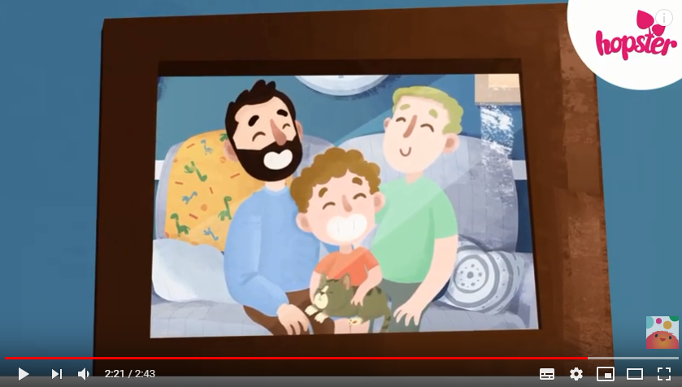
Watch: Rainbow Stories
Notes:
https://www.youtube.com/watch?v=wLb-ylUL6GY
We are going to start by watching a video about James and his two daddies – Peter and Mark. While you are watching, try and see what kinds of things they like doing together as a family.

Slide 4
Follow-up questions
What are some of the things James and his family like to do together?
What do we call it when someone finds a new ‘forever family’, like James did with Daddy Mark and Daddy Peter?
How is this family different to your family?
How is this family similar to your family?
Notes:
What are some of the things James and his family like to do together? Answers: dancing, making dens, BBQs, telling stories, telling jokes, listening to each other and helping if they are sad
What do we call it when someone finds a new ‘forever family’, like James did with Daddy Mark and Daddy Peter? Answer: adoption
How is this family different to your family? Answers: two dads, adopted, have a cat, dad is archeologist etc.
How is this family similar to your family? Answer: have fun together, love each other, play together, talk together when feeling sad etc.

Slide 5
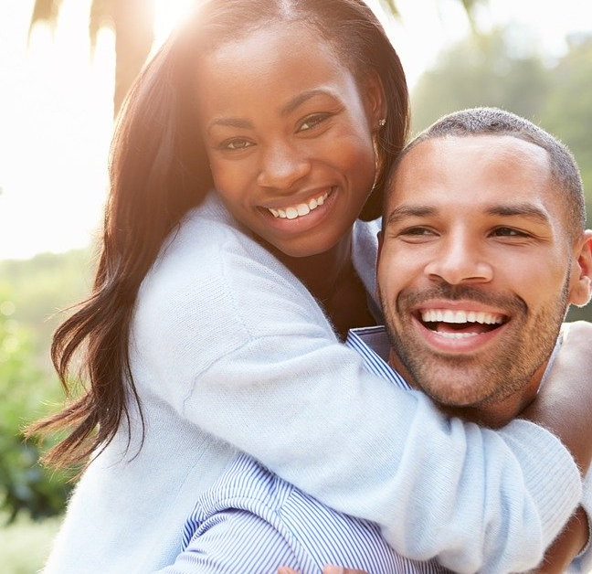
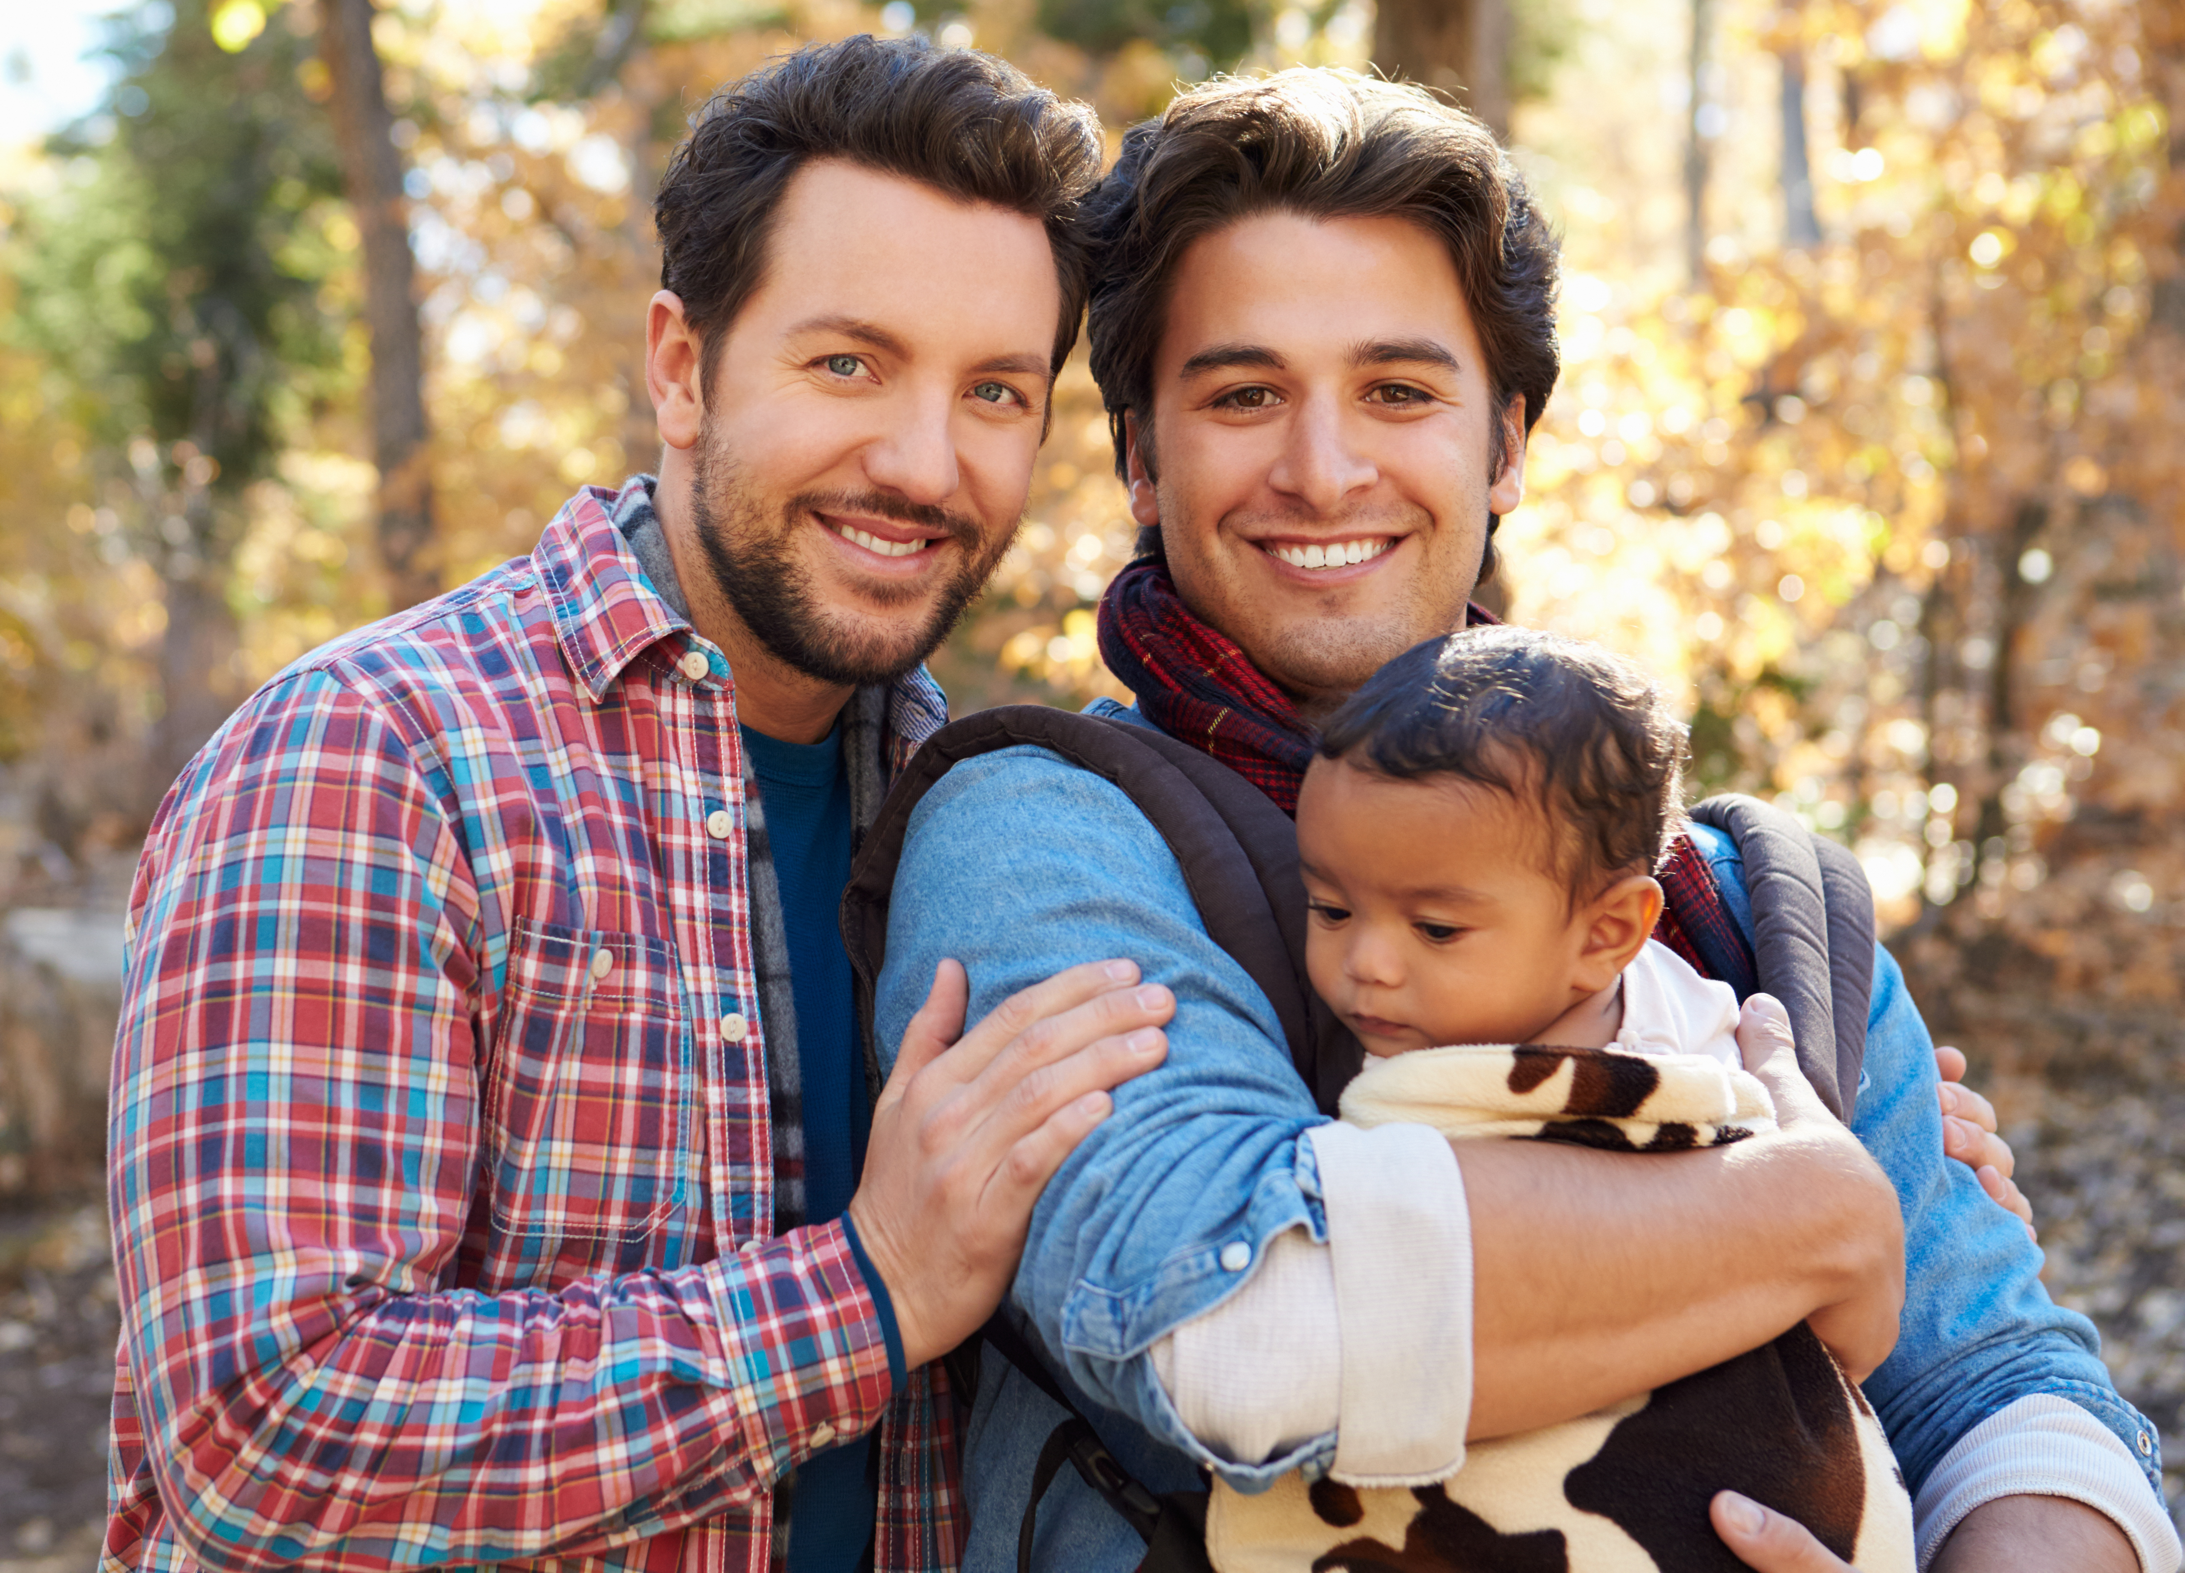
Discuss: How many differences can you see?
Notes:
Sexual orientation – heterosexual and gay (note some or all the people could be bisexual!)
Mixed race
Some families have children

Slide 6
Discuss: How many similarities can you see?
Notes:
Smiling
Together
Happy
Love each other
Have fun
Trust
Support

Slide 7
Celebrating our differences
At this school we celebrate all the ways in which we are unique and different. Be that a different race, religion, family, hobbies or anything that makes you and your family special.
Think about one thing that makes you unique
Share that with the person next to you
On the count of three, shout it out for everyone to hear!
Notes:
Think-Pair -Share

Slide 8
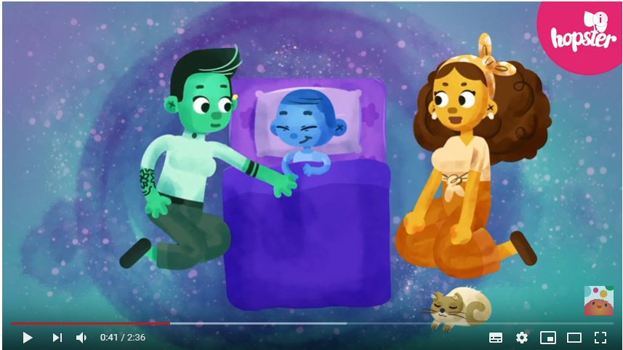
Sing along: Love is love
Chorus:
Love is love,
Love is love,
Love is, love is, love.
Love is love.
Notes:
https://www.youtube.com/watch?v=Yh1C0u4uBso
Now we are going to sing a song called Love is Love – it is all about celebrating our differences and understanding that families can all look different, some may have two mums, two dads, but love is what is important. Sing along to the chorus, the words are very easy!

Slide 9
www.diversityrolemodels.org
info@diversityrolemodels.org

